Slide 1
TECH SENSEI
GADGET RECOMMENDATION SYSTEM

Slide 2
PROPOSED SOLUTION
AI based recommendation system specially designed for electronic gadgets
Simple UI
User profile free interaction
Top pick suggestions
Easy filtration
Specially tuned K-means algorithm to match user input
Wide range of data collected(Data collection)
Data cleaned(Data pre-processing)

Slide 3
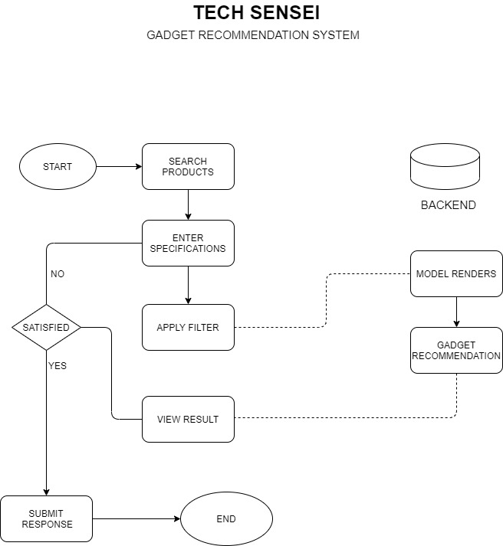
ARCHITECTURE DIAGRAM
-PROJECT FLOW

Slide 4


MODULES
PLANNING AND IDEA PHASE
REAL WORLD PROBLEM IDENTIFICATION
EXAMINING EXISTING SOLUTIONS
CREATING OPTIMIZED SOLUTION
DEVELOPMENT PHASE
DATA COLLECTION
DATA PRE-PROCESSING
UI WIREFRAME DESIGNING
MODEL DEVELOPMENT
INTEGRATION PHASE
FINE TUNING MODEL
INTEGRATING TRAINED MODEL WITH UI
DEPLOYMENT PHASE
BUILDING UX
TESTING UNIT
MARKET FIT
BUSINESS MODEL
DEPLOYMENT IN ECOSYSTEM

Slide 5
THANK YOU!

